Slide 1


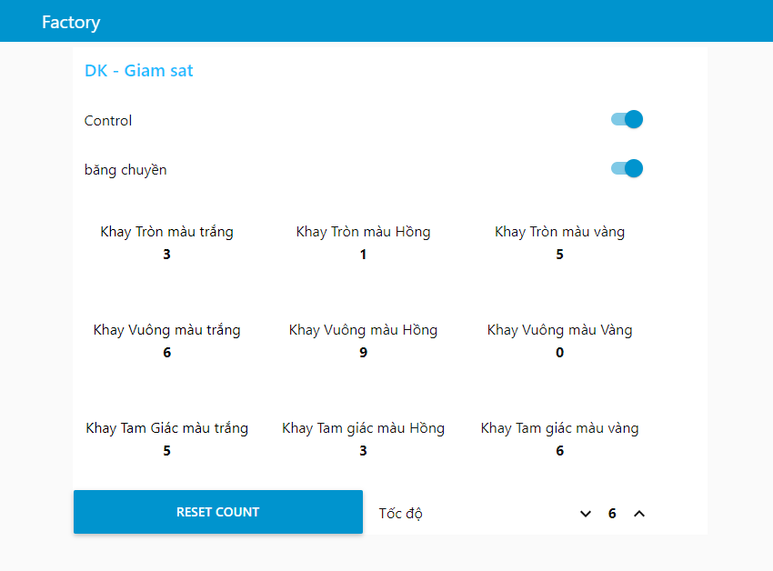
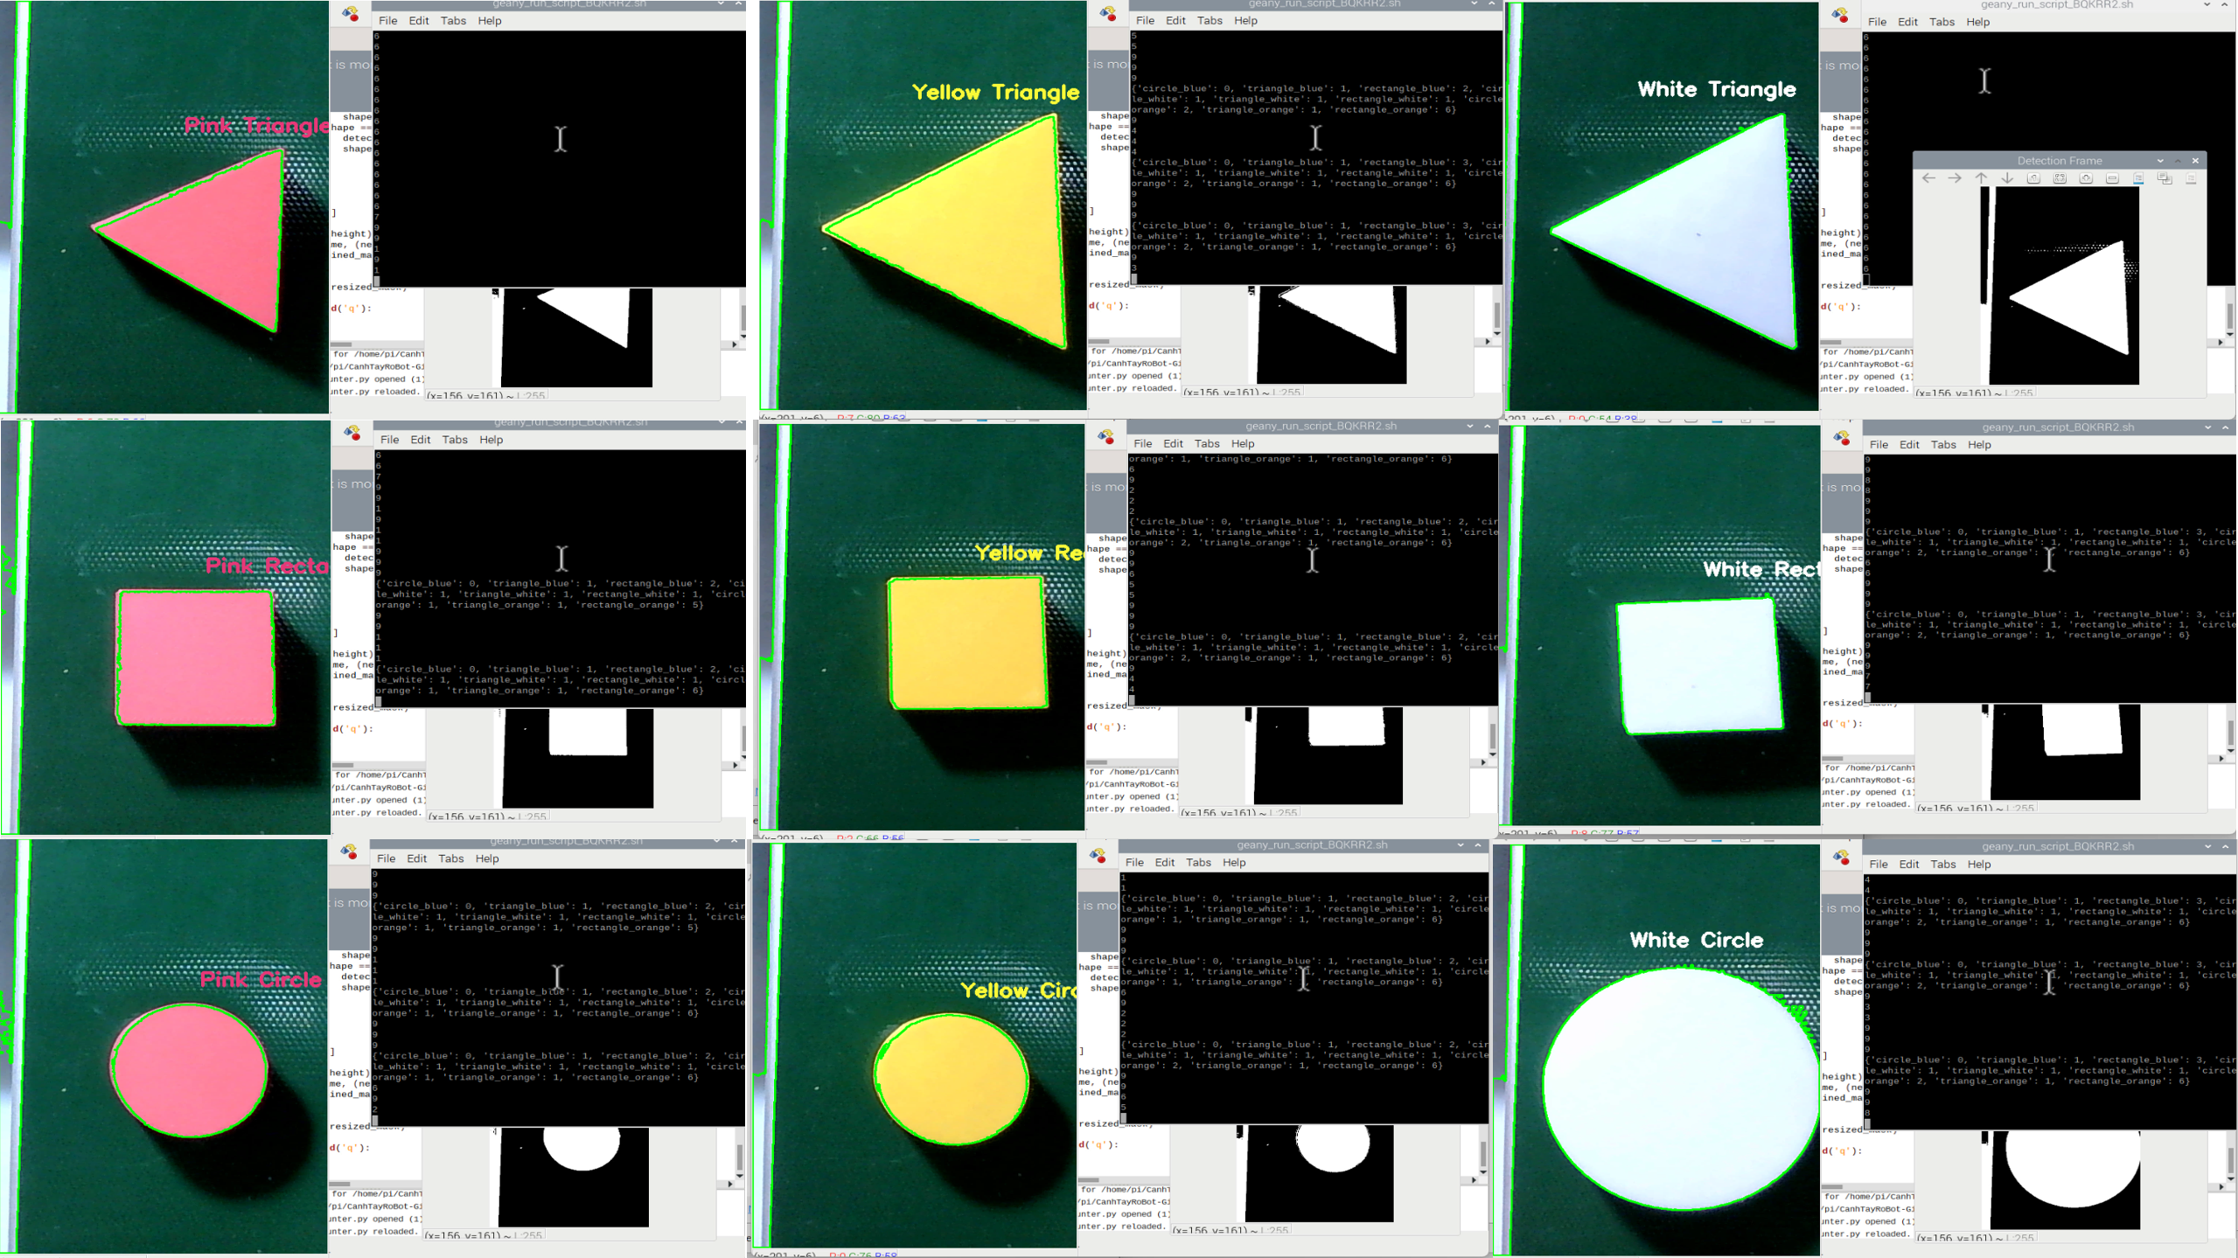
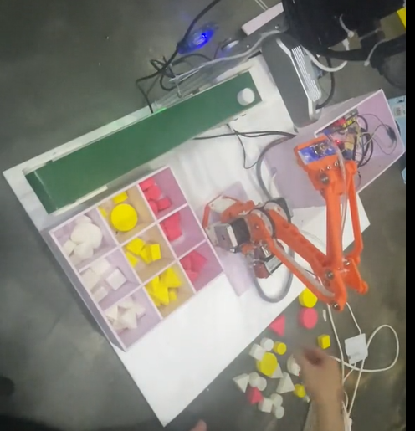
DESIGN AND IMPLEMENT A ROBOT ARM FOR SORTING PRODUCTS BY COLOR AND SHAPE
Student: Dinh Nguyen Gia Phu – Advise by: MS. Thieu Quang Tri
Department of Automatic Control, Faculty of Electrical Engineering, Ton Duc Thang University
OBJECTIVE
INTRODUCE
Build image processing algorithm.
Build robot arm control algorithm.
Design of step down and chopper circuit to control DC motor
Build user interface for control and monitoring.
Use Webcam and image processing algorithm to detect and classify products by color and shape.
Receive data and control the pick and drop of objects as required. Provide users with a simple monitoring interface.
ACTIVE
Using Webcam to capture real images. After receiving the images, process the colors and shapes on Rasberry using Python.
The processed signals are transmitted to Arduino to convert into pulse signals and send pulses to the control motors of the Robot joints.
From the interface, we can monitor the color processing process and related information such as: product quantity, on/off control and conveyor speed.
RESULT
Advantages:
Capable of processing colors and classifying products, picking and placing objects in the desired positions as specified by the user.
Building a user interface to display basic information: showing the number of products by color, monitoring the image processing process.
A compact model that solves the problems of space and flexibility.
Disadvantages:
Due to the low quality of the webcam, it is easily affected by light interference, leading to errors in environments with poor lighting or excessive light.
The robot is controlled in an open loop, resulting in low accuracy; it is necessary to solve the trajectory planning problem for the robot arm.
When the motor works too much, it overheats, causing step loss.
The control program is not yet optimized.
CONCLUSION
THANK YOU
Able to process colors and shapes accurately.
Need to solve the problem of trajectory planning for the Robot arm.
Meet the requirements of the problem.
Need to improve and change the design to make the model more optimal.
I sincerely thank MS. Thieu Quang Tri for his assistance in helping me complete this graduation project.
REFERENCES
Bugs. (2024, March 21). Xử LÝ Ảnh Với opencv: Các Phép Toán Hình Thái Học. IO Stream. https://www.iostream.co/article/xu-ly-anh-voi-opencv-cac-phep-toan-hinh-thai-hoc-Nljcg
Nguyễn, T. P. (2006). Giáo trình Robot công nghiệp. Nhà xuất bản Khoa học và Kĩ thuật.
Nguyễn, T. T. (2017). Robot công nghiệp. Đại học Sư Phạm Kĩ Thuật.
GRADUATION THESIS- FACULTY OF ELECTRICAL ENGINEERING - TON DUC THANG UNIVERSITY

